Slide 1

Introduction to Data Visualisation
The Good, The Bad and The Ugly
Dr Joe Roberts
jroberts@harper-adams.ac.uk
NERC Entomology Summer School 2024

Slide 2


Who am I?
Lecturer in Integrated Pest Management
Chemical ecologist but increasingly a data scientist
R user for ~ 15 years and Python user for ~ 5 years
Developed several R resources
Packages - olfactometeR
Shiny apps – pesticide toxicity calculator

Slide 3
Overview
Data and stories
Why visualise data
Effective data visualisation
Graphs in R

Slide 4
What is data visualisation?
Method of representing data in a graphical format
Useful for exploring and communicating results
Equal parts art and science
Challenge is to get the art right without getting the science wrong
(and vice versa!)

Slide 5
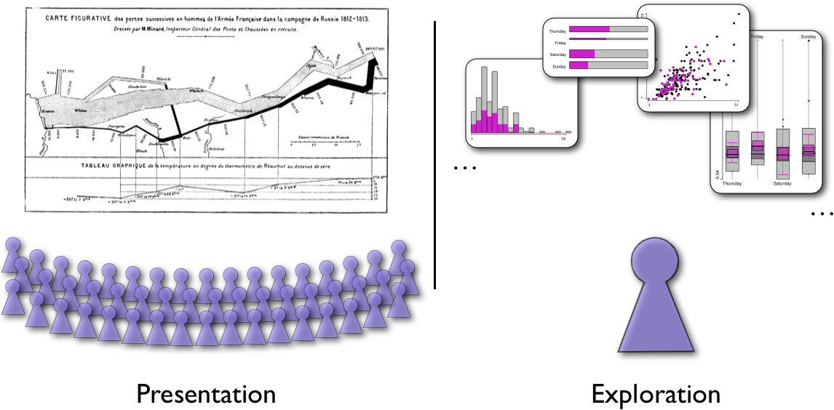
Data and Stories
Data and Stories

Slide 6
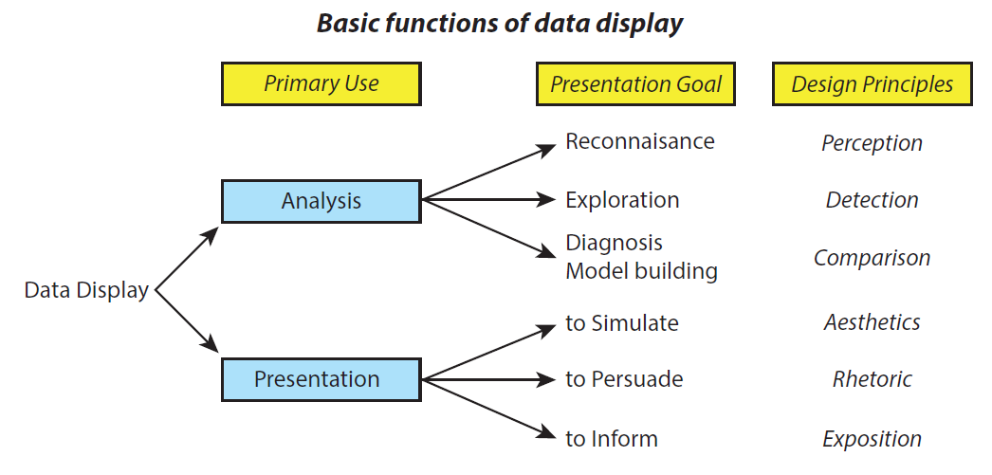
Roles of graphs in communication
Graphs and tables are forms of communication
What is the audience?
What is the message?
Analysis graphs: design to see patterns, trends, aid the process of data description, interpretation
Presentation graphs: design to attract attention, make a point, illustrate a conclusion

Slide 7
Different graphs for different purposes
Presentation
graphics
Analysis
graphics
Wow!
Ah ha!
Goal: the Wow! Experience
Single image for a large audience that tells a clear story!
Goal: the Ah ha! Experience
Many images, for a narrow audience and linked to analysis!

Slide 8
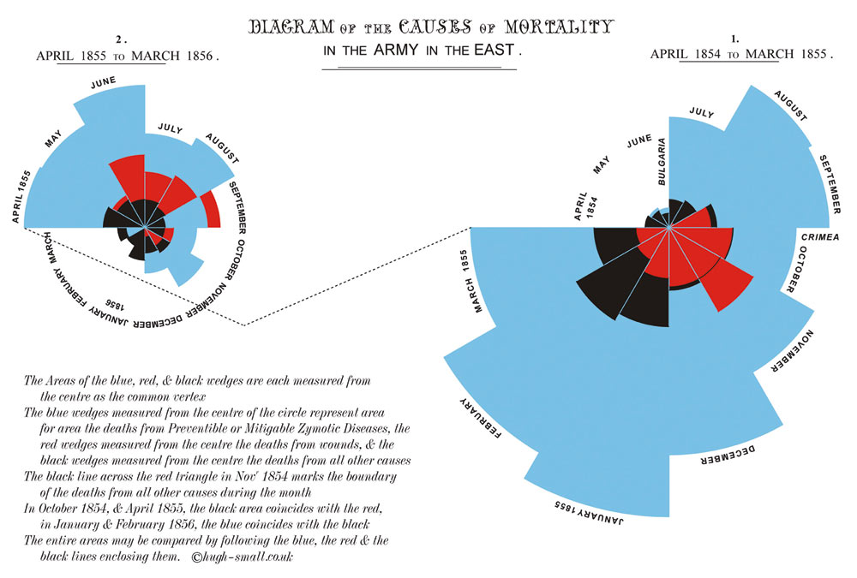
Presentation graph – Nightingale (1857)
After reform
Before reform
preventable
wounds
other
The best graphs pass the Interocular Traumatic Test:
The message hits you between the eyes!

Slide 9
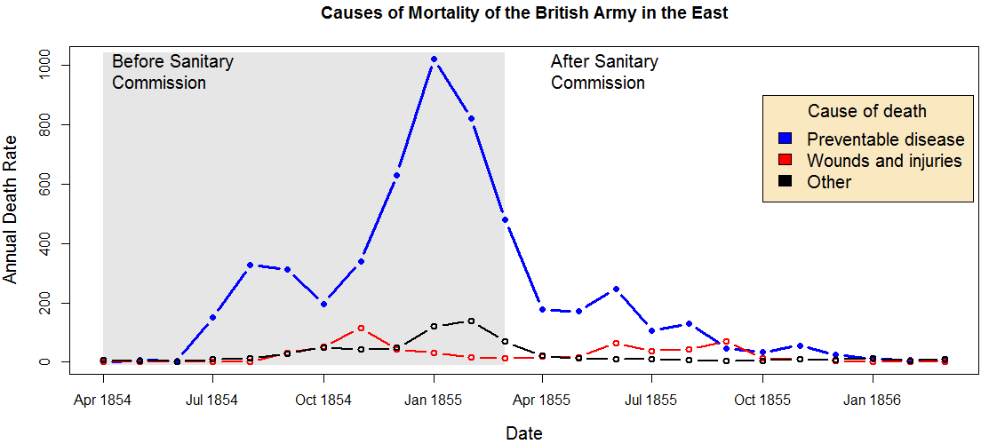
Analysis graph – Nightingale (1857)
The same data as the previous graph but as time-series line plots
Many statisticians might prefer this today, but it doesn’t draw attention or interest as Florence Nightingale’s original did. It likely would not have caused Parliament to act!

Slide 10
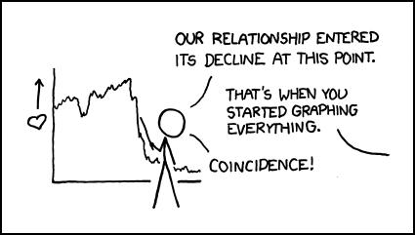
Why Visualise Data?

Slide 11
Why do we visualise data?
Graphs are just pretty pictures
Don’t add anything to data interpretation
You can derive all important information from summary statistics
Tables are ‘good enough’
WRONG!

Slide 12
Summary statistics can be deceptive!
Matejka and Fitzmaurice (2017) Same Stats, Different Graphs. CHI’17.

Slide 13
A picture is worth a thousand words
We can’t gain valuable, meaningful insights from raw data
Graphs provide a cognitively ‘easy’ way to explore patterns in data
Outliers, distributions, relationships, etc.
Graphs emphasise findings and insights for audiences
‘A thousand words leave not the same deep impression as does a single deed.’ - Henrik Ibsen

Slide 14
Processing information
~90 % of environmental information is received through the eyes
~50 % of brain neurons are involved in processing visual information
We remember 10 % of what we hear, 20 % of what we read and 80 % of what we see!
People perceive 70% of the information if there are no images
Add images and this figure increased up to 95%
Images increase desire to read the text by ~80 %
McLeod (2018) Visual perception theory. Simply Psychology.

Slide 15
Pattern recognition makes us human
Mattson (2014) Superior Pattern Processing is the Essence of the Evolved Human Brain. Frontiers in Neuroscience.

Slide 16
Sometimes we’re too good at finding patterns
Pareidolia: seeing patterns that aren’t there
Must be careful not to find patterns when there aren’t any!

Slide 17
Visualising data is important
Always graph your data – even if you don’t use it
Harder to hide any surprises – though not impossible!
Makes data more compelling and accessible – data doesn’t speak
Complement tables of data or statistical results – both contribute

Slide 18
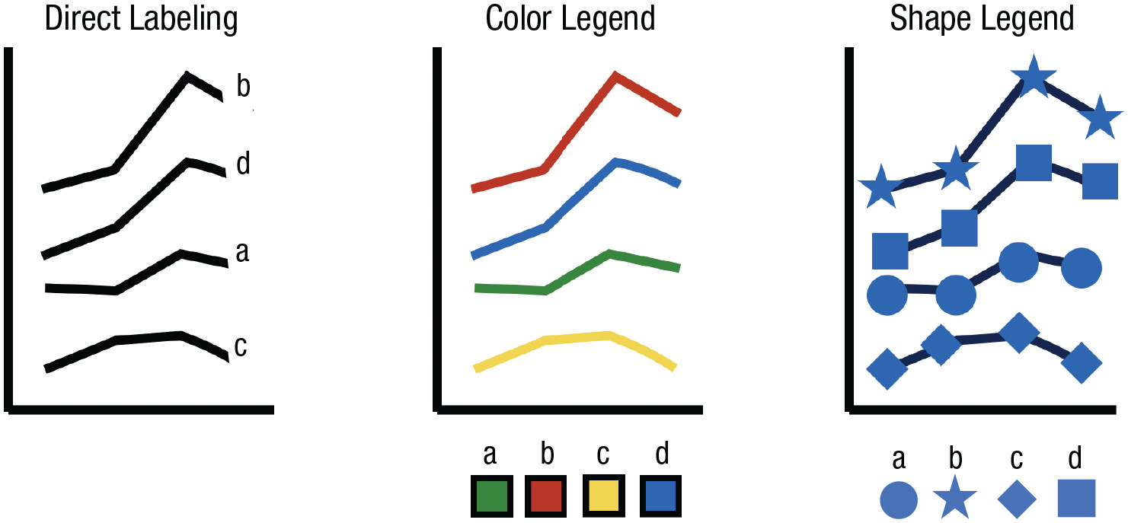
Effective Data Display

Slide 19

Let’s get critical
15 mins
Split into small groups (2 or 3)
Find 2 or 3 graphs from the peer-reviewed scientific literature - preferably from three different manuscripts
Carry out a critique of these graphs and determine whether they are: ‘good’, ‘ugly, ‘bad’ or ‘wrong’
Ugly - a graph that has aesthetic problems
Bad - a graph that has problems related to perception
Wrong - a graph that has problems related to the data it displays
Briefly outline how the graphs could be improved
Notes:
Tufte quote

Slide 20

Edward Tufte – Patron Saint of Data Viz
‘Graphical excellence is the well-designed presentation of interesting data—a matter of substance, of statistics, and of design … [It] consists of complex ideas communicated with clarity, precision, and efficiency. … [It] is that which gives to the viewer the greatest number of ideas in the shortest time with the least ink in the smallest space … [It] is nearly always multivariate … And graphical excellence requires telling the truth about the data.’
Tufte (1986)

Slide 21
Distilling Tufte’s message
Let the data speak – show as much information as possible
Make it easy to decode numerical information
Science not sales – avoid unnecessary thrills
Be accurate – tell the truth

Slide 22
Effective data display
Choose the right type for your data and to facilitate understanding
Minimise chart junk
Facilitate comparisons w/ position, colour and alignment
Use colour sparingly
Use text to provide context
Notes:
Tufte quote

Slide 23
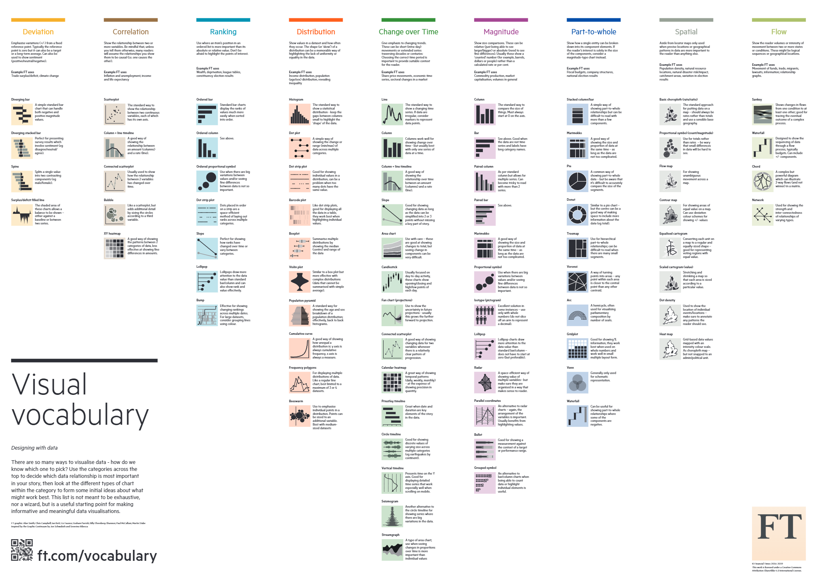
What kind of graph should you use?
What is it that you want to show?
What information are you trying to convey?

Slide 24
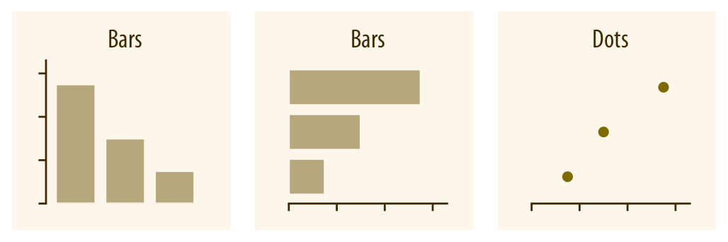
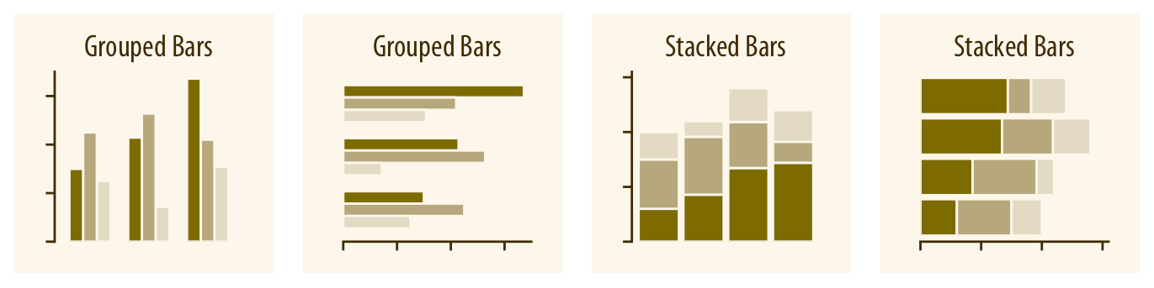
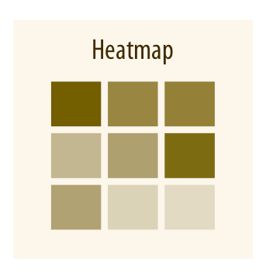
Amounts
Bar/Dot Plots:
Ordering important. e.g., age should be in order of variable, not in order of response
More than one variable:
Grouped, stacked bars
Heatmaps
Depends on data – what conveys message best

Slide 25
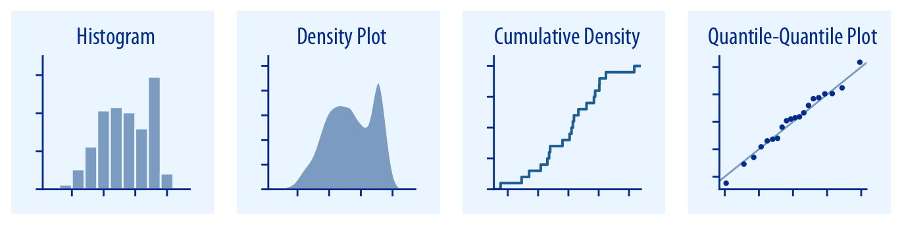
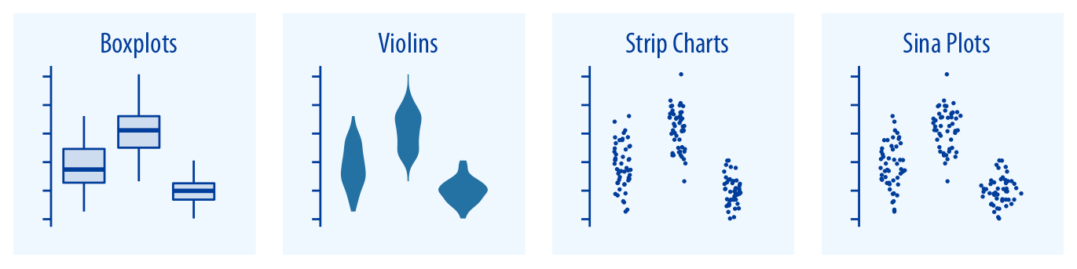
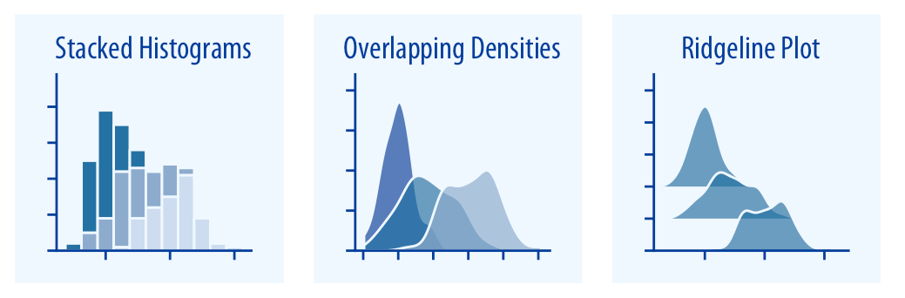
Distributions
Distributions
Conveys more information about an individual variable
May be used to determine distribution of data to inform statistical tests
Most instances may have ‘grouped’ options also:
Boxplots, violins, stacked histograms etc.
Don’t overload with data

Slide 26
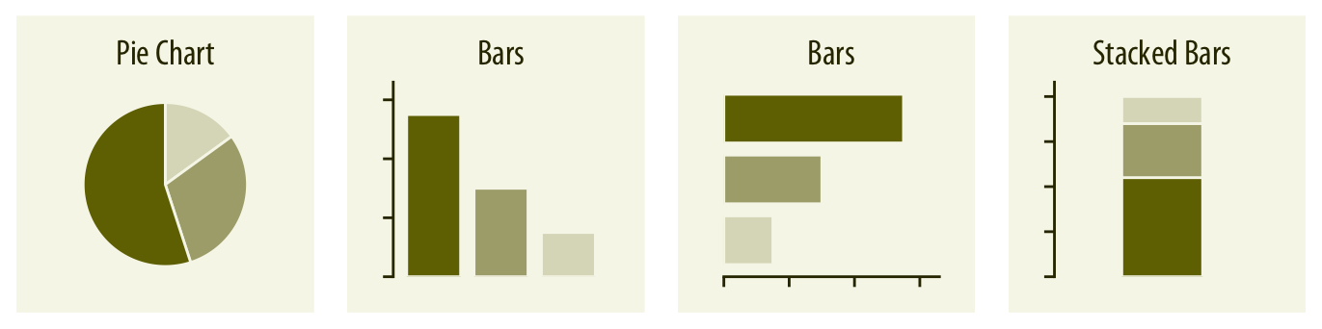
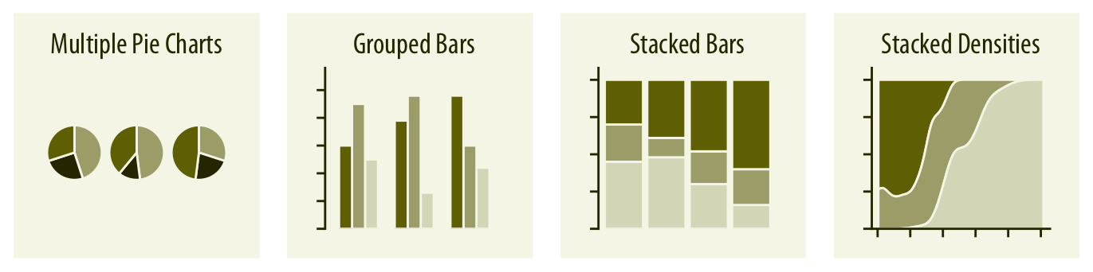
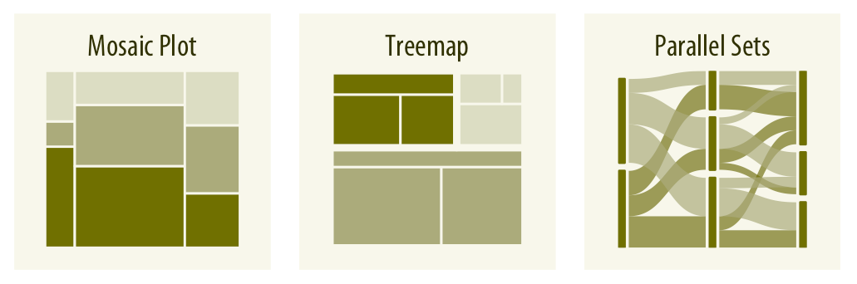
Proportions
Proportions
Highlight variables as elements of the whole
Pie charts – common in business, avoid in science. Lacks units and accuracy
Dependent on selection – may obscure other elements of your data
Mosaics a good option, lots of information conveyed simply. Effective

Slide 27
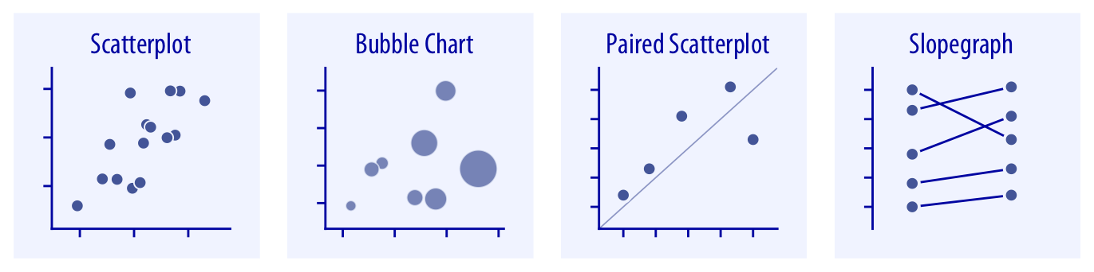
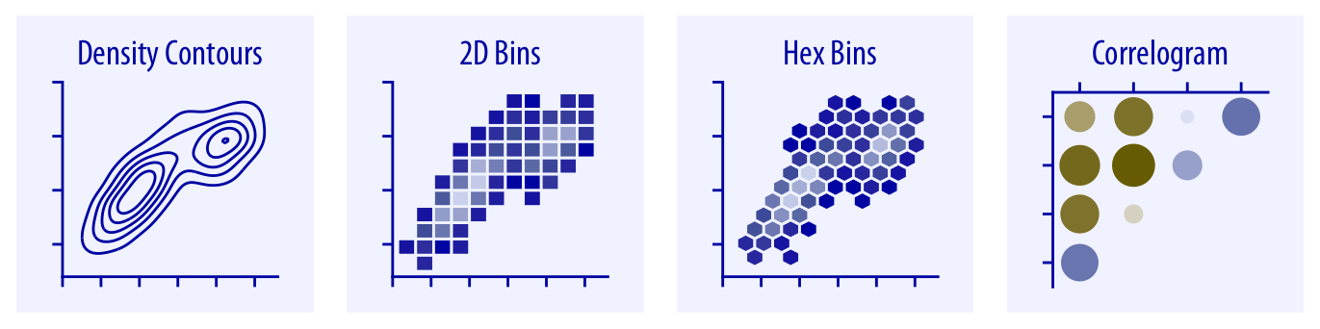
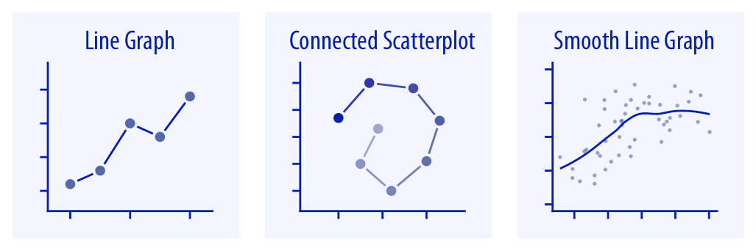
x-y relationships
Associations
Can easily illustrate how two variables relate directly to one another
Good for correlations
Allows for simple visual representation of statistical outputs, e.g., regression lines
Can demonstrate strength of relationships among several variables, e.g., correlogram
Effective for complex datasets and multiple interactions, e.g., NMDS, PCA

Slide 28
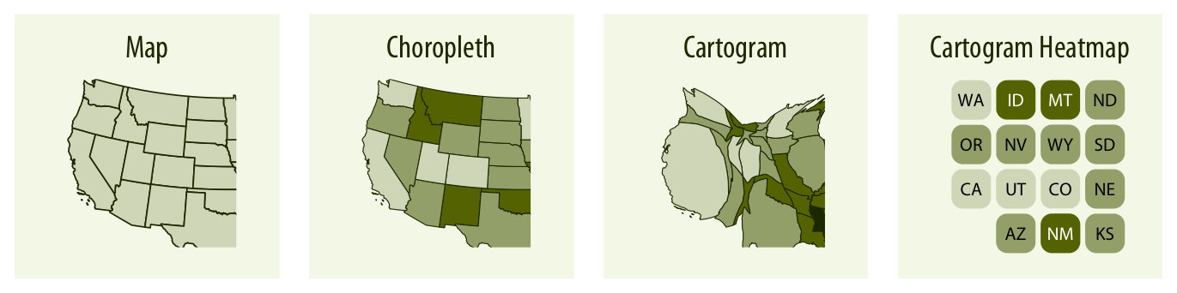
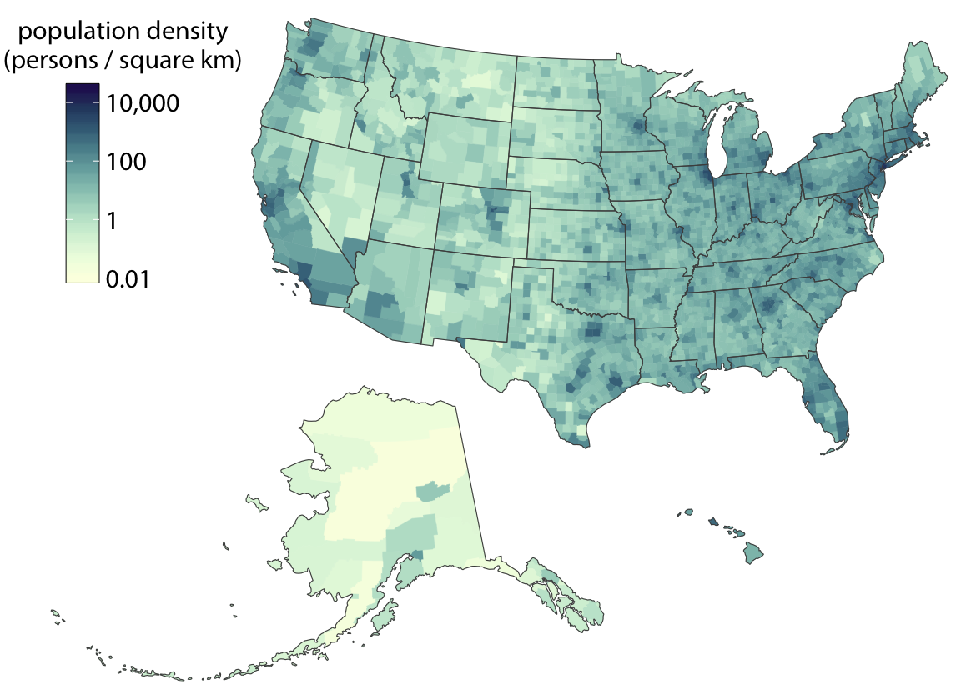
Geospatial
Mapping
May be relevant for some of your MRPs – although not touched on much in the module
Location of surveyed organisms – ecology; highlighting areas of activity – agroecology; animal movement – ruminant biology
May be localised or large scale
Uses same principle as heat mapping to illustrate differences in variables across mapped locations

Slide 29
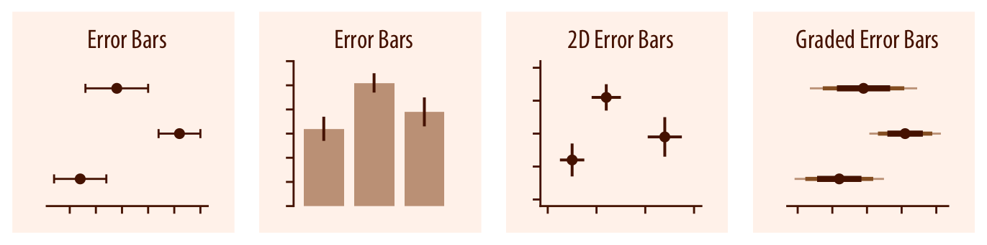
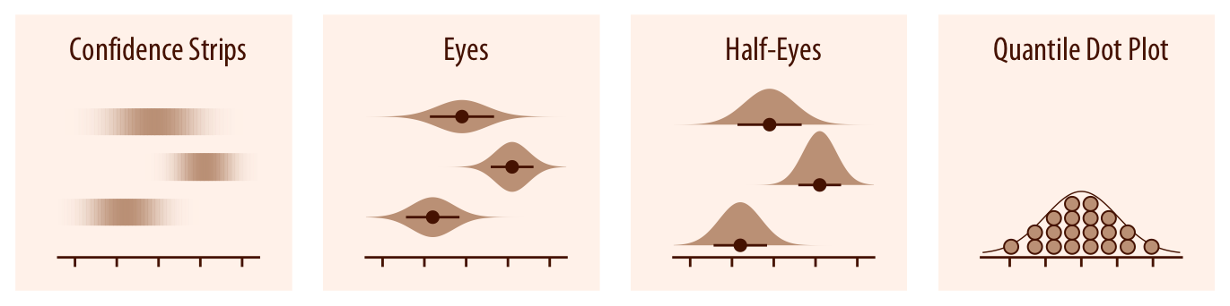
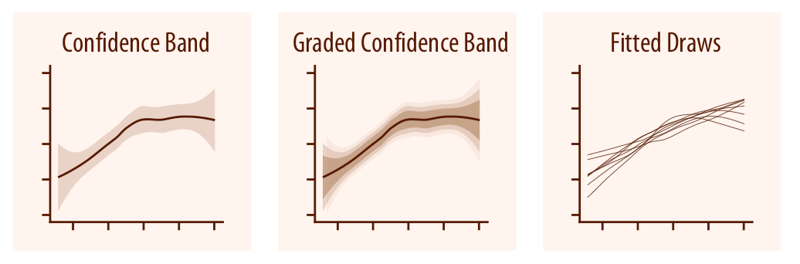
Uncertainty
Measure of the Data
Additions to existing plots or distinct plots to indicate uncertainty within the descriptive or applied statistics presented
Most common: error bars
Often several measures presented at once – e.g., graded error bars

Slide 30
Effective data display
Choose the right type for your data and to facilitate understanding
Minimise chart junk
Facilitate comparisons w/ position, colour and alignment
Use colour sparingly
Use text to provide context
Notes:
Tufte quote

Slide 31
Make the data stand out
Maximise the data-to-ink ratio
Remove anything that distracts from the purpose of the graph
Every element of the graph must positively contribute
Do not use defaults…
‘Above all else, show the data.’ – Edward Tufte
Notes:
Tufte quote

Slide 32
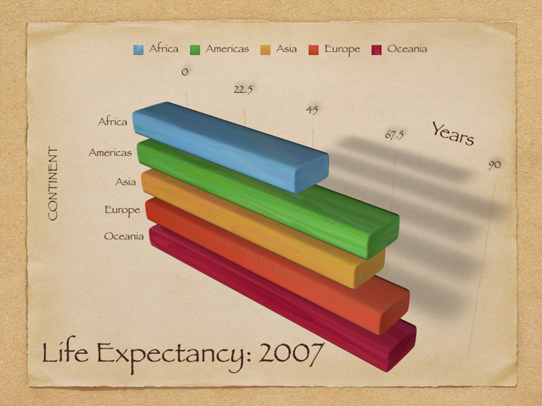
Chart junk
Notes:
Tufte quote

Slide 33
Effective data display
Choose the right type for your data and to facilitate understanding
Minimise chart junk
Facilitate comparisons w/ position, colour and alignment
Use colour sparingly
Use text to provide context
Notes:
Tufte quote

Slide 34
Facilitate comparisons
Things to be compared should be adjacent
Add (a bit) of colour
Ensure figures are aligned
Use a common axis
Notes:
Tufte quote

Slide 35
Effective data display
Choose the right type for your data and to facilitate understanding
Minimise chart junk
Facilitate comparisons w/ position, colour and alignment
Use colour sparingly
Use text to provide context
Notes:
Tufte quote

Slide 36
Exercise restraint with colour use
Colour can be an incredibly effective tool
But it can easily be abused and ruin a good graph
Use needs to serve a purpose and not distract your audience
Consider colour blindness – check with this tool
Notes:
Tufte quote

Slide 37
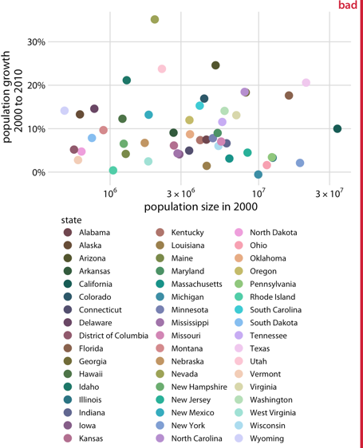
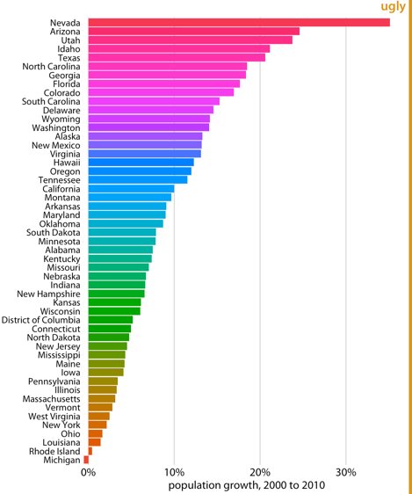
Bad uses of colour
Wilke (2019)
Notes:
Tufte quote

Slide 38
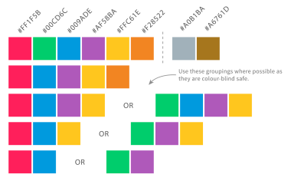
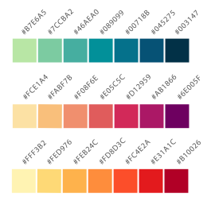
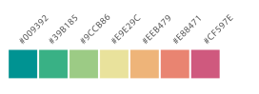
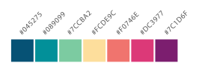
Colour
Qualitative – for discrete or categorical data
Sequential – for quantitative data ordered from low to high
Diverging – for deviations from a mean or zero

Slide 39
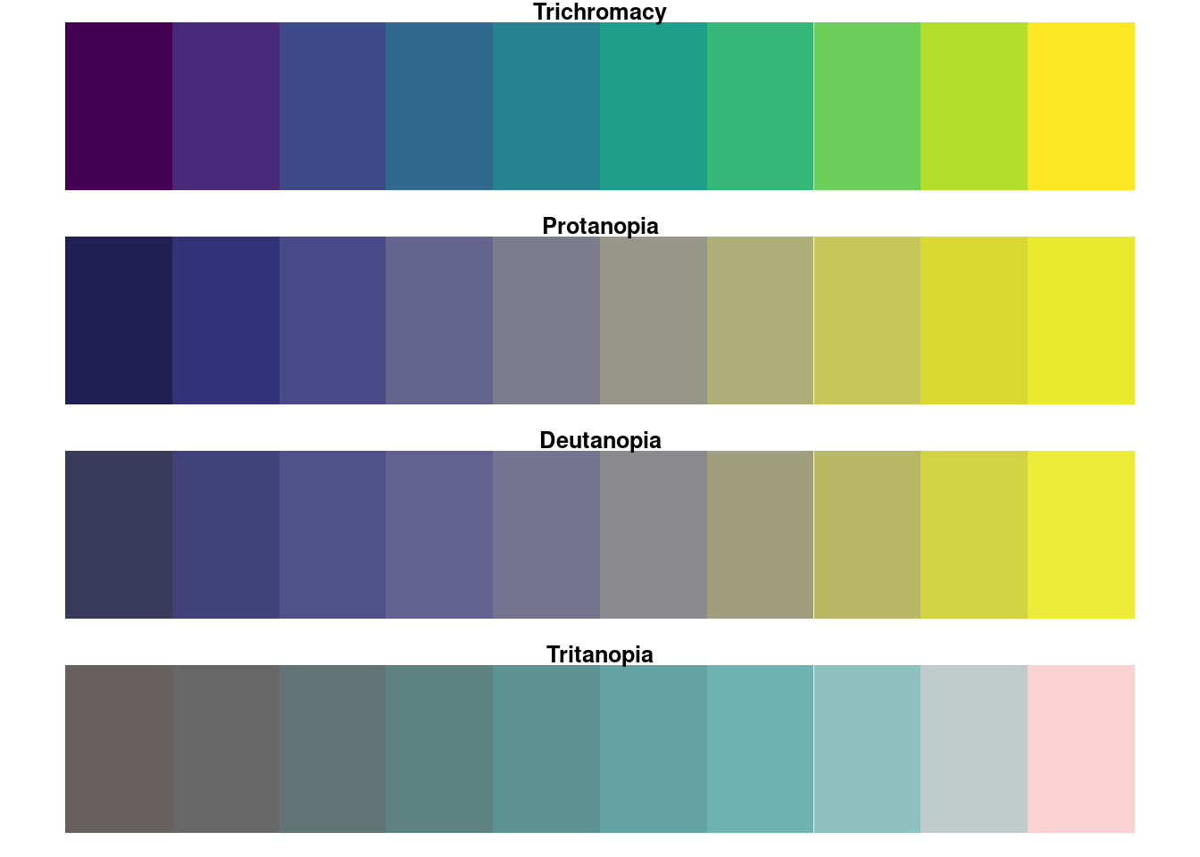
Colour blindness
Approx. 1 in 20 people are colourblind
They will see a reduced colour space
What may appear as two distinct colours to you may appear the same to someone with colour blindness
Tools to help find colour friendly palettes
e.g., viridis
Best way – don’t rely on colour!
Use variations in symbols, text, labelling, patterns, line styles etc.

Slide 40
Effective data display
Choose the right type for your data and to facilitate understanding
Minimise chart junk
Facilitate comparisons w/ position, colour and alignment
Use colour sparingly
Use text to provide context
Notes:
Tufte quote

Slide 41
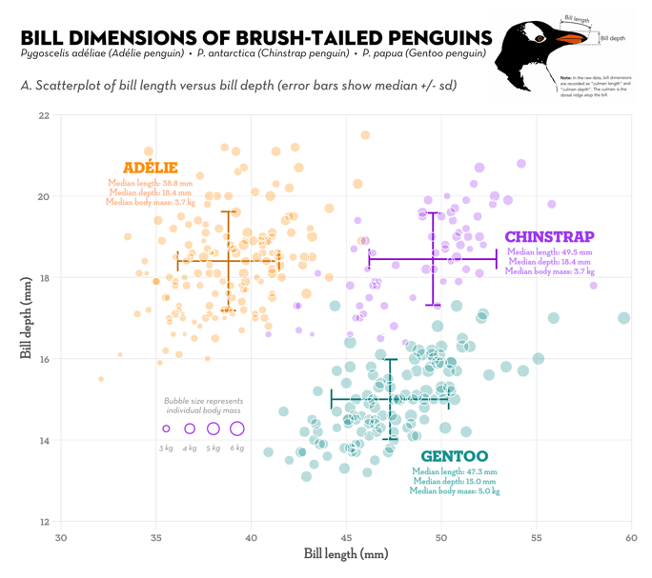
Use text where possible
Data visualisations are not just a piece of art
Need to convey information and make a point
Place data into context using titles, captions and annotations
Notes:
Tufte quote

Slide 42
General presentation
Titles above uncommon – definitely not ‘A graph to show…’. We know it is!
Avoid gridlines! Generally, keep backgrounds minimal. Focus on the data
Axis units clear and evenly spaced – appropriate to show trends, careful not to mask or exacerbate
Colour needs to suit the data – distinct categories = distinct colours. Not diverging or difficult to tell apart
Mean Percentage Repellency (%)
Axis titles appropriate, include units where needed, angled correctly
Treatment
Figure caption must stand apart from the main text and fully describe the figure it’s supporting in isolation
Figure legend always at bottom for graphics, top for tables
Figure 1. Mean percentage repellency scores for five essential oils tested against wireworm in a no-choice terrarium olfactometry assay. No food source included. A positive value indicates repellency, a negative value indicates attraction, calculated as stated in section 2.2.8. Error bars indicate 95% CI.

Slide 43
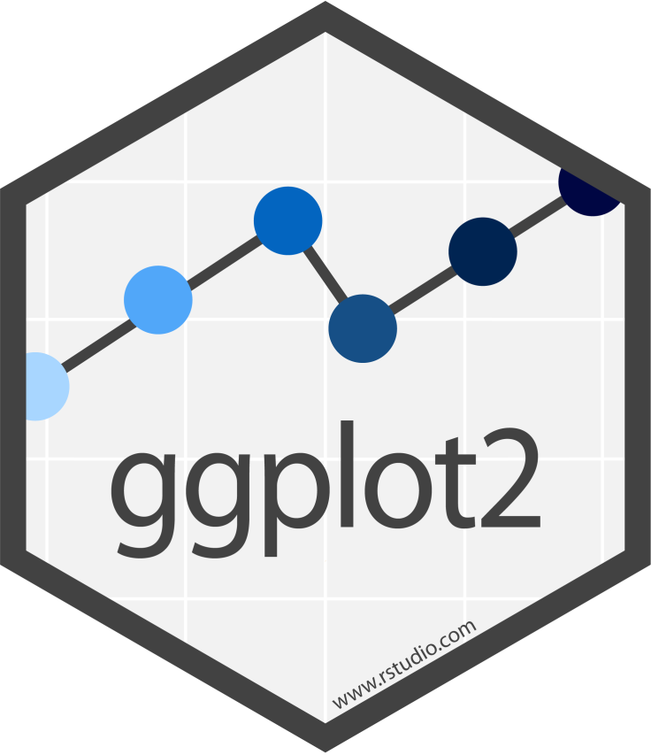
ggplot2

Slide 44
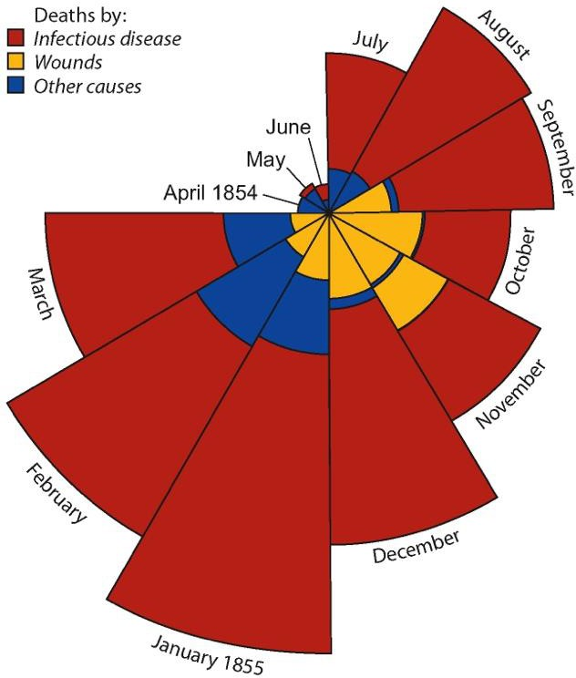
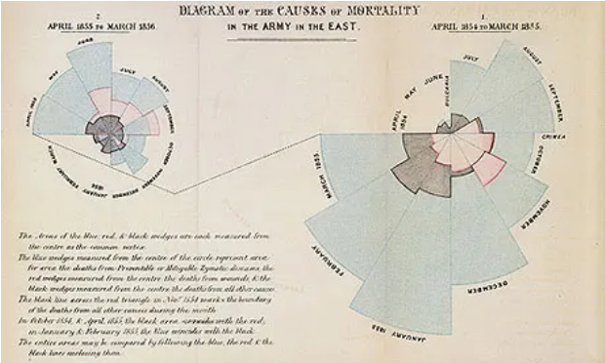
How do we make graphs?

Slide 45






How do we make graphs?

Slide 46
R plotting ecosystem
R comes with built-in functionality for plotting – base R
Packages extend R plotting functionality – ggplot2, lattice, etc.
Debate as to which approach is better
Pro base R plots – Jeff Leek
Pro ggplot2 plots – David Robinson

Slide 47
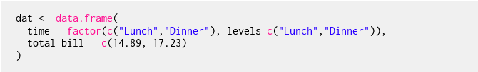
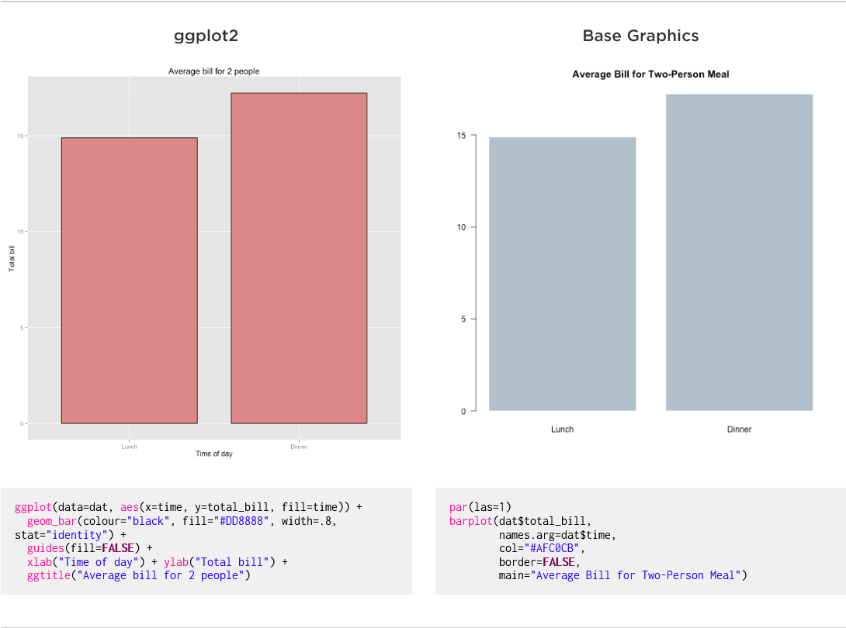
Bar plots

Slide 48
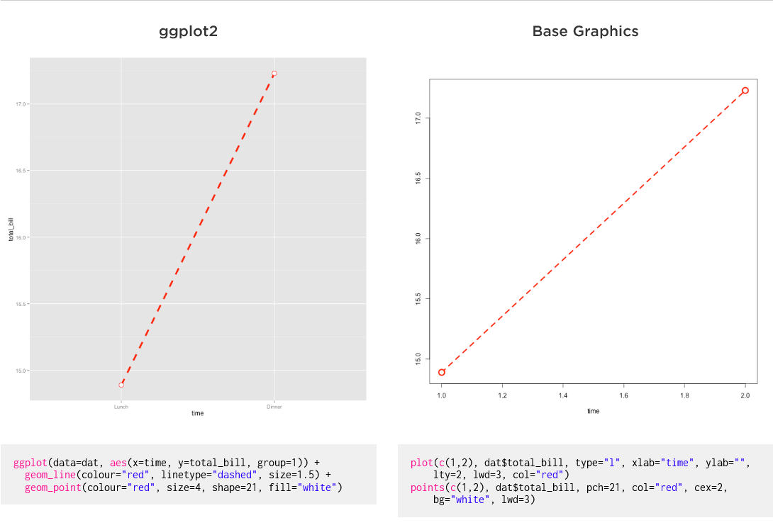
Line plots

Slide 49
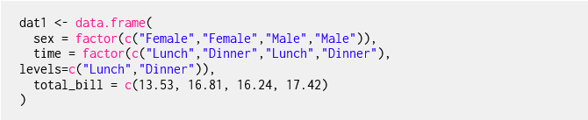
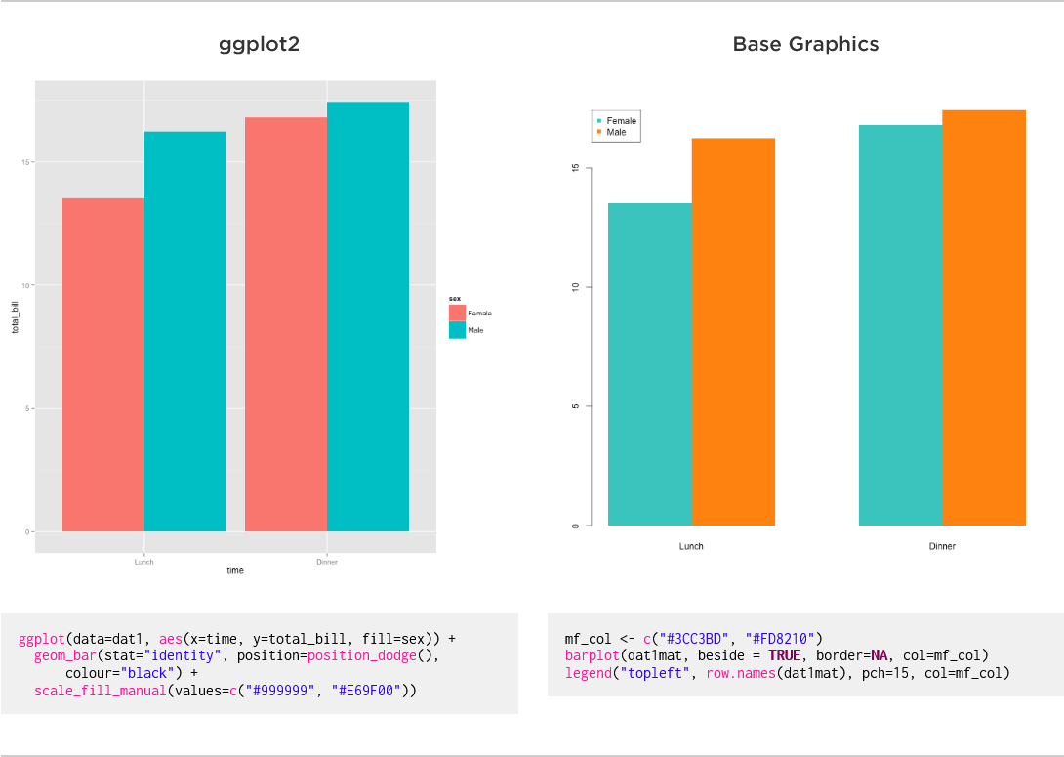
Multiple variables

Slide 50
So, which is better?
Depends on your perspective and needs
I personally use ggplot2 in my day-to-day work
Use whichever you are most comfortable with
Wildcard option: use an alternative such as lattice

Slide 51
ggplot2 functionality
Currently 134 registered extensions
Independently developed and not officially part of ggplot2
Greatly increase functionality
Can be found here: https://exts.ggplot2.tidyverse.org/gallery/

Slide 52
gganimate

Slide 53
esquisse

Slide 54
Graph challenge
25 mins
Split into small groups (2 or 3)
Download the Aphid VOCs data from GitHub
Create a simple visualisation of this data using any software
Adhere to the best practices we have covered
Notes:
Tufte quote

Slide 55
Summary
Data visualisation represents data in a graphical format
Graphs are a form of communication that aim to tell a story
Knowing your audience helps to choose the right type of graph
Humans are visual organisms so exploit this!
Graphs emphasise findings and insights for audiences

Slide 56
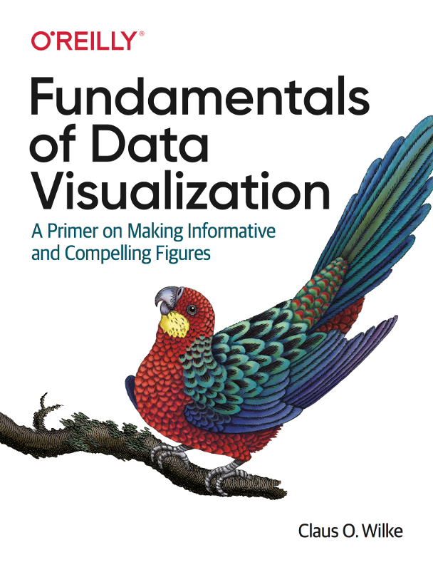
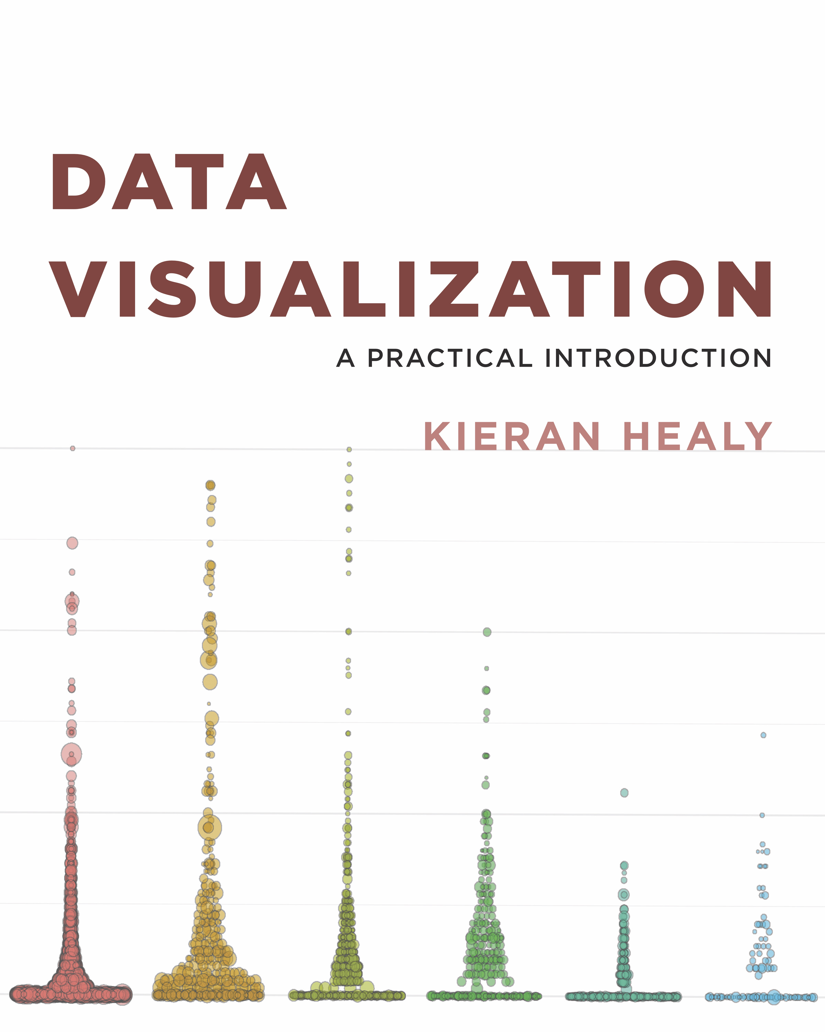
Books I like
[LINK]
[LINK]

Slide 57
Websites I like
Best Practices for Data Visualisation (Royal Statistical Society)
From Data to Viz
R Graph Gallery

